Slide 1

Week 3: Communication: Sharing what we know
COMU7311, Sem 1, 2021
School of Communication and Arts, UQ

Slide 2
Learning Objectives
At the end of this lecture, you should be able to:
Recognise the complex nature of communication.
Critically examine widely known models of communication.
Evaluate the influence of culture on communication.

Slide 3
What is communication?
Neurologists: what the brain and nervous systems do during communication;
Psychologists: how the brain functions and perception related issues;
Linguists: how people use language;
Philosophers: whether communication is essential to thought;
Anthropologists: whether communication is universal;
Scientists: how data transfer from one location to another.
Each of the above carves out but one piece within the territory
of human communication.

Slide 4
The linear model
Noise
Encoding
Decoding
Source
Message
Channel
Receiver
Feedback
Receiver response
Source: Adapted from Shannon, Claude and Weaver, Warren (1949) The Mathematical
Theory of Communication. Urbana: University of Illinois Press. p. 5.

Slide 5
The interactive model
Message
Encoder
Interpreter
Decoder
Decoder
Interpreter
Encoder
Message
Source: Adapted from Schramm, Wilbur (1971) ‘The nature of communication between humans’, in W. Schramm and D. F. Roberts (eds.), The Process and Effects of Mass Communication. Urbana: University of Illinois Press, p. 24.

Slide 6
Defining communication
Communication can be defined as the process by which people use shared verbal or nonverbal codes, systems and media to exchange information in a particular cultural context.
We all share our ideas and feelings with others; however, how we interpret “codes” may vary from person to person, from group to group, and from culture to culture.

Slide 7
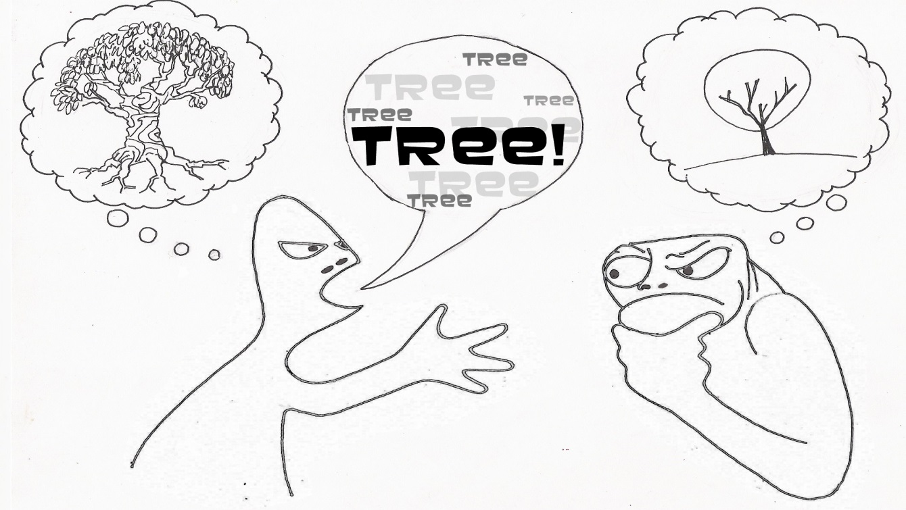

Slide 8
Questions to think about…
How do initial experiences with language shape the way in which a person thinks?
Do words, grammar, and usage influence how people think and behave?
Does a person growing up in Saudi Arabia, who learns to speak and write Arabic, “see” and “experience” the world differently than a person who grows up in Australia, speaking and writing English?

Slide 9

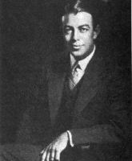
The Sapir-Whorf hypothesis
Edward Sapir 1884-1939
Benjamin Whorf 1897-1941
Linguistic determinism – the way one thinks is determined by the language one speaks.
Linguistic relativity – Language provides the conceptual categorises that influence how its speaker’s perceptions are encoded and stored.

Slide 10
Communication and culture
Culture and communication mutually influence one another.
Culture teaches us rules (e.g. politeness rules, the way we dress, etc.).
Culture cultivates beliefs and values.
Culture teaches us how to develop relationships with others.

Slide 11
My language, my people, my world
Speech patterns, dialect, and accent serve as a cue for listeners to assign certain attitudes or characteristics to an individual or a group of people.
Identity based on ethnic language also hinges on an assumption that one’s linguistic community is acceptable in a number of ways.
Cultural invasion occurs when one group penetrates the culture of another group and imposes its own language on another group.

Slide 12
Culture at play…
What are some characteristics of Australian accent?
Where did Australian accent come from?
How is Australian accent related to Australian identity?

Slide 13
Language and identity
Language is a vital aspect of any cultural group’s identity.
Nationalists defend their national language against foreign “pollution”. Immigrant groups maintain their cultural heritage and identities by teaching it to their children.
Language maintenance and shifting suggest the maintenance and shifting of culture.

Slide 14
After class…
Can theories of communication express universal principles that apply to all cultures? Or communication is so culturally variable that culture-specific theories are needed. What is your view on this debate?

Slide 15
Next week
Week 4’s lecture will focus on processes of social categorisation and perception.

